Slide 1

Sparkify
Big Data final project
Mohil J

Slide 2

Overview
Introduction
Dataset
Conclusion
Annexure (Snippet of code for reference)

Slide 3
Introduction
Business problem & What are we trying to solve:
The data is from a fictitious music streaming service such as Spotify or Pandora.
Millions of consumers rely on music streaming services daily, choosing between free tiers with ads or premium memberships for added features and an ad-free experience. User satisfaction is vital as it impacts their decisions to upgrade, downgrade, or cancel their plans.
User interactions with music streaming apps generate valuable data that includes playing songs, playlist management, ratings, friend additions, logins, settings changes, and more. These activity logs provide crucial insights to gauge user satisfaction and improve the service.
Goals:
Primary Goal:
Our goal is to develop a binary classifier that accurately detects Sparkify music streaming service users, regardless of their subscription tier, who have canceled their membership. By analyzing their past activity and interactions, we aim to train a model that can predict churn and identify users likely to cancel in advance.
Secondary Goal:
Evaluate the performance of multiple classification algorithms
Select the best-performing model based on evaluation metrics and cross-validation results.

Slide 4

Data set
The mini-dataset file is `mini_sparkify_event_data.json`
No of Rows – 286500 & No of Columns – 18
Checked the data for missing values.
Transformed the original Sparkify dataset (one row per log) to a dataset with user-level information or statistics (one row per user)
Constructed several numerical features that in our opinion capture well the patterns in user's past activity and interaction with the music streaming service, and could be used to identify churned users
Included three extra features that reflect user's interaction patterns: avgsessionitems, avgsessiontime and avgsongs.
label : binary response variable, where:
1 represents churned users who cancelled the subscription (irrespective of the subscription plan, free or paid) within the observation period between October 1 and November 30;
0 represents users who kept the music streaming service throughout the observation period

Slide 5

Interesting Insights
On average churned users played more songs per hour;
Churned users gave significantly more thumbs down per hour, and had to watch more advertisements on average;
The ratio of songs and positive interactions relative to total activity was typically lower for churned users
Churned users had on average less interactions per session
Churn rate is higher for users in the free subscription plan
Churn rate is slightly higher for male users

Slide 6
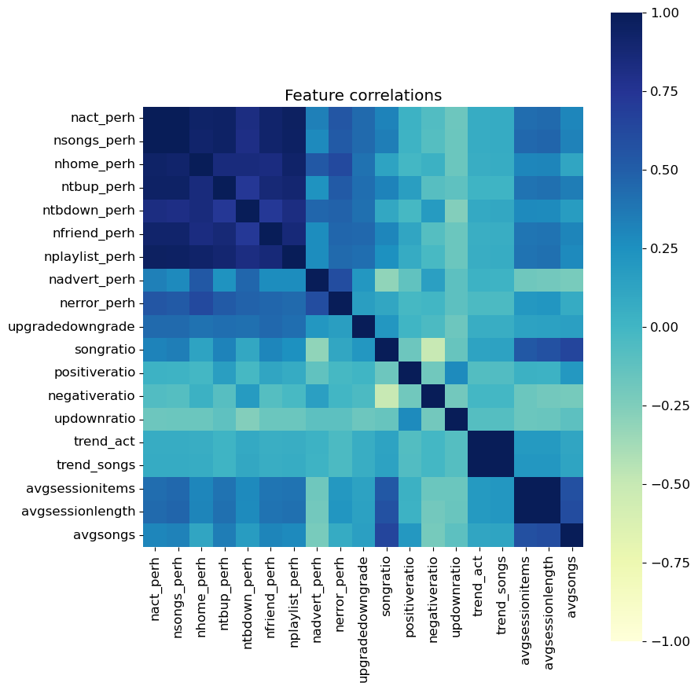
Visualisation

Slide 7
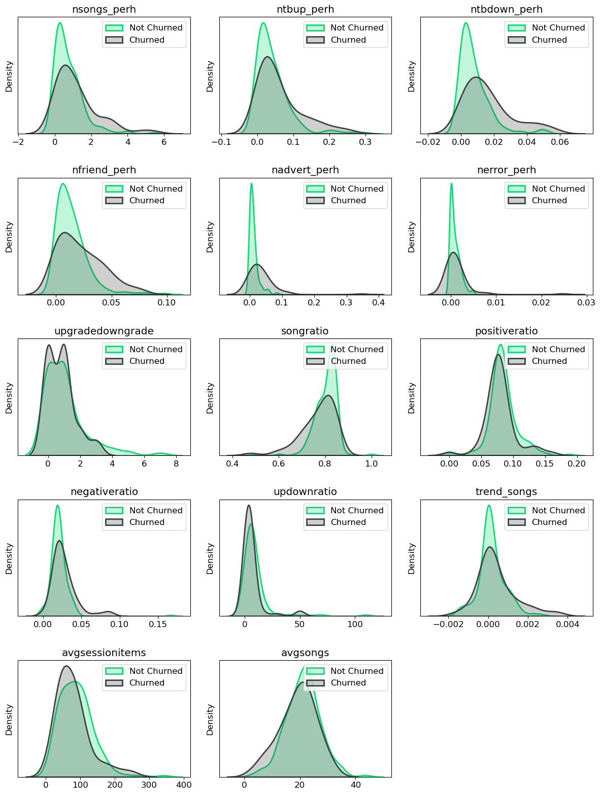

Slide 8
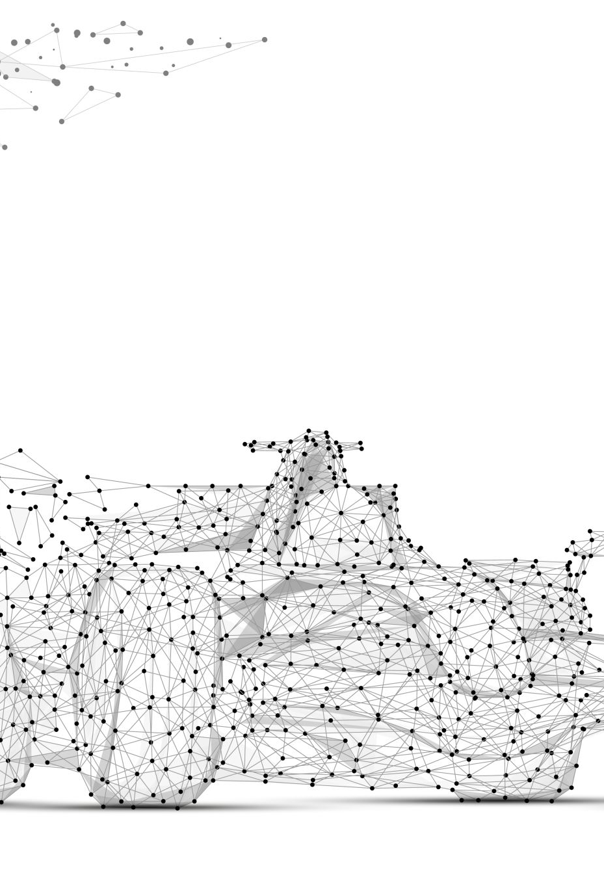
Modeling and Evaluation
Used Spark's machine learning capabilities to build pipelines that first standardize and combine the engineered features
We have performed grid search with cross validation to test several parameter combinations for different classifiers
Based on the performance results obtained in cross validation (measured by F1 Score), we have then selected models with best parameter combinations and retrained them on the entire training set
Built three different Pipeline objects for three binary classifiers supported in Spark: Logistic Regression, Random Forest Classifier and Gradient-Boosted Tree Classifier.
The input feature dataset consists of:
14 numerical features :- nsongs_perh, ntbup_perh, ntbdown_perh, nfriend_perh, nadvert_perh, nerror_perh, upgradedowngrade, songratio, positiveratio, negativeratio, updownratio, trend_songs, avgsessionitems, avgsongs
2 binary features :- lastlevel and gender
Dataset has been split into training and test set using the 80/20 ratio.
During the model tuning the training set is used in 4-fold cross validation so it is further split into multiple training and validation folds

Slide 9
Modeling Training and Evaluation
For each defined binary classifier/pipeline we have carried out the following steps:
1. Performed grid search with 4-fold cross validation by fitting the defined CrossValidator object on the training data
2. Identified the parameter combinations that return the best F1 score in cross validation
3. Retrain the best model instance/pipeline on the entire training set
4. Analyzed feature importance's
5. Evaluated the selected model instance on the test set using F1 score metric

Slide 10
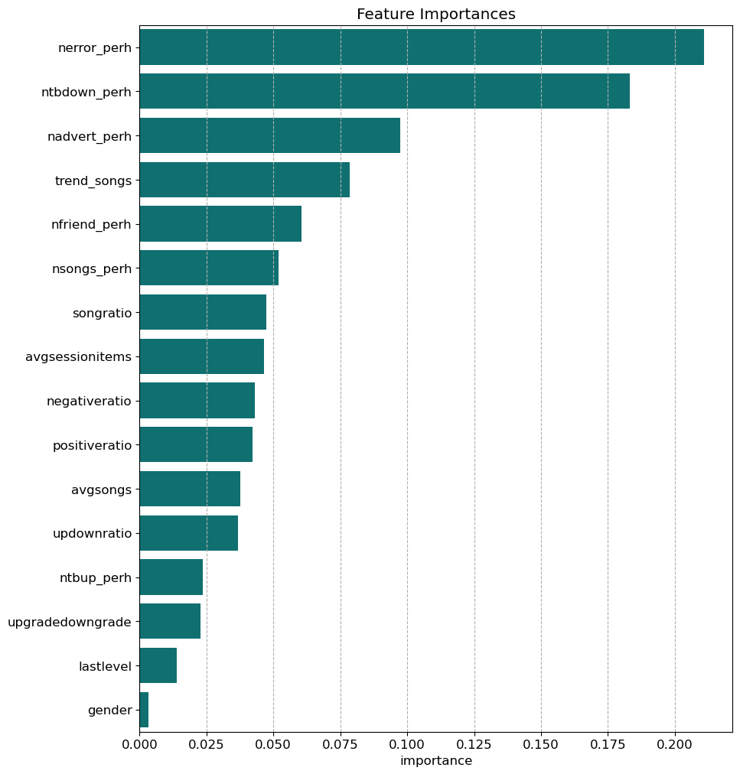
Feature Importance
As seen in the visualization, the most important feature for identifying churned users is the nerror_perh which measures how many error pages have been shown to the user per hour. Intuitively, the more errors a user has to experience the more likely it is that he/she is dissatisfied with the service.
Similar holds also for the second and third most important feature, ntbdown_perh and nadvert_perh which measure the number of thumbs down given per hour and number of advertisements seen per hour, respectively.
Despite all the extra calculations, it was worth including in the feature set also the 4th most important trend_songs variable which measures user's song listening activity trend.
The two binary features, namely lastlevel (i.e., the last known subscription level) and gender, do not contribute much to predicting churned users.
Performed PCA for dimension reduction
90% variation was explained by variables till 15
Performance of model without PCA and scaling of data for Top 5 clusters performed better than PCA

Slide 11
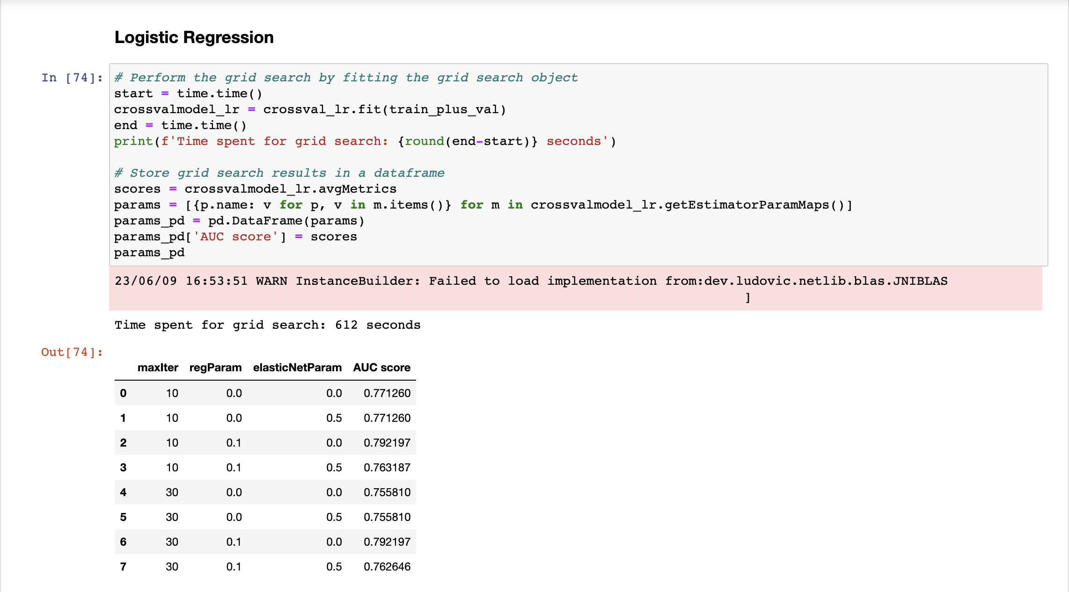
Algorithms
Random Forest
K-NN

Slide 12
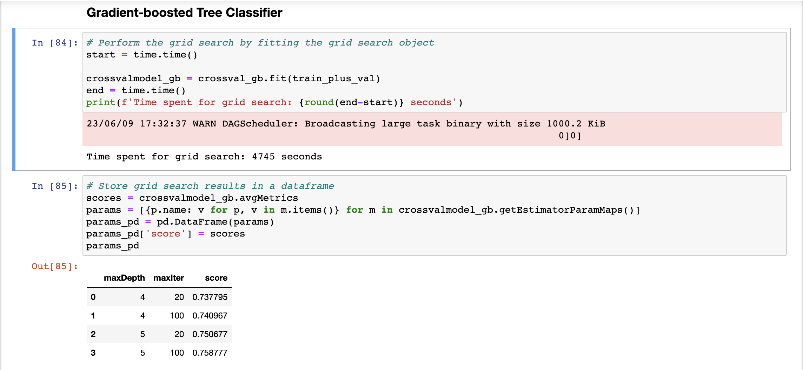
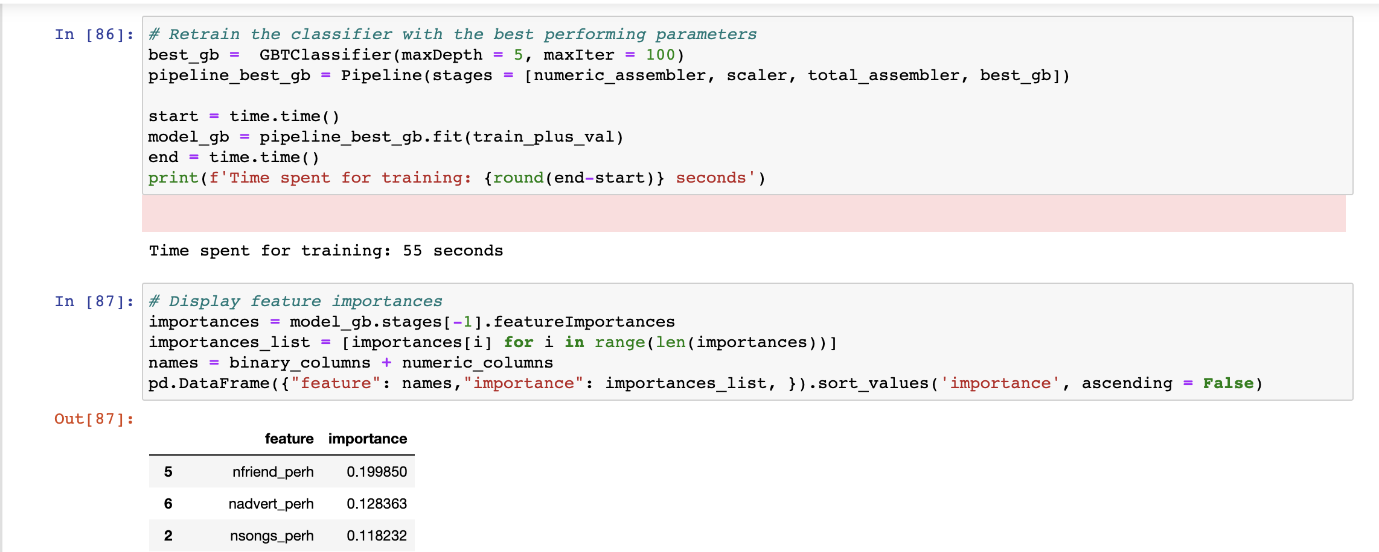
Random Forest
K-NN

Slide 13
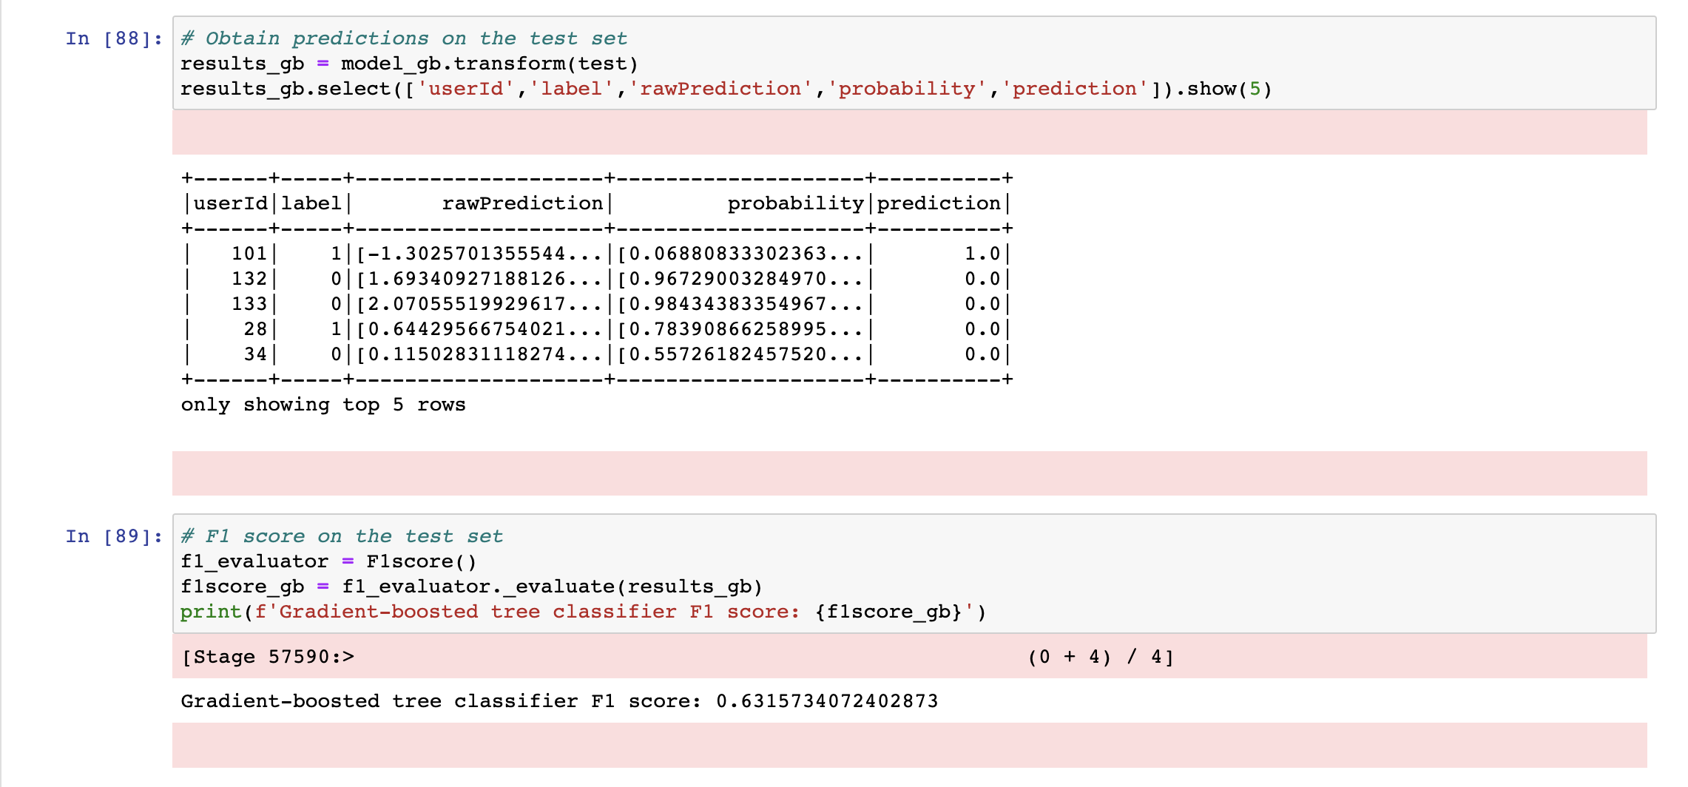
Random Forest
K-NN

Slide 14
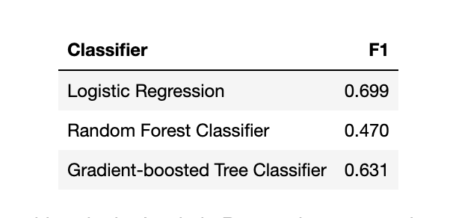
Conclusion
The F1 scores show a significantly weaker performance, with only the Logistic Regression approach scoring a solid 0.699. The above F1 scores have been obtained using the default 0.5 threshold.
It is important to note that these outcomes are consistent with models that were developed and evaluated using the Sparkify dataset, which includes a smaller total of only 225 unique users. Accordingly, the models are evaluated on a sample of 46 occurrences, of which only 10 (on average) are positive classes.
*

Slide 15
Thank You

Slide 16
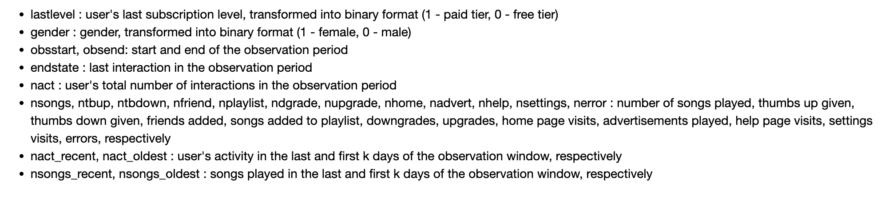
Annexure – List of Variables

Slide 17
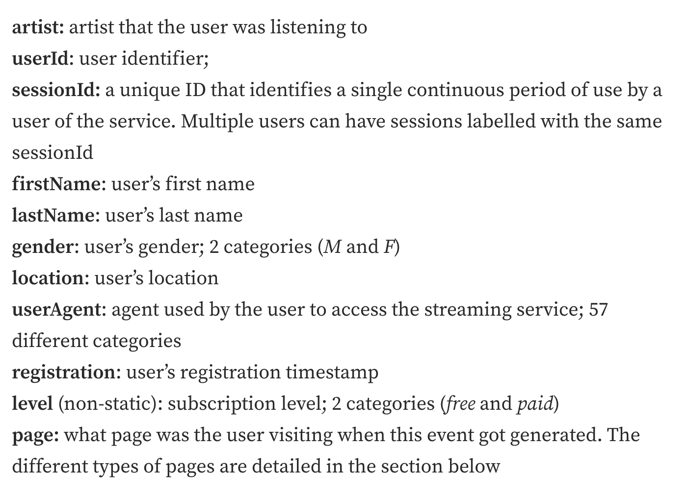
Annexure – List of Variables

Slide 18
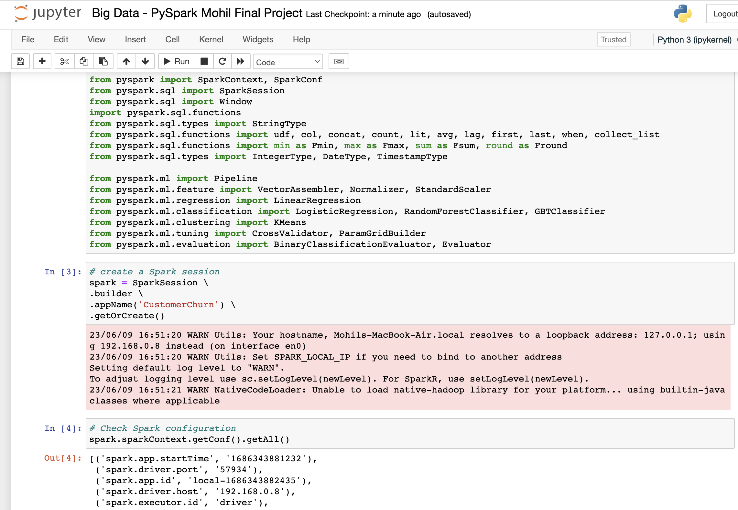
Annexure – Snippet of Code

Slide 19
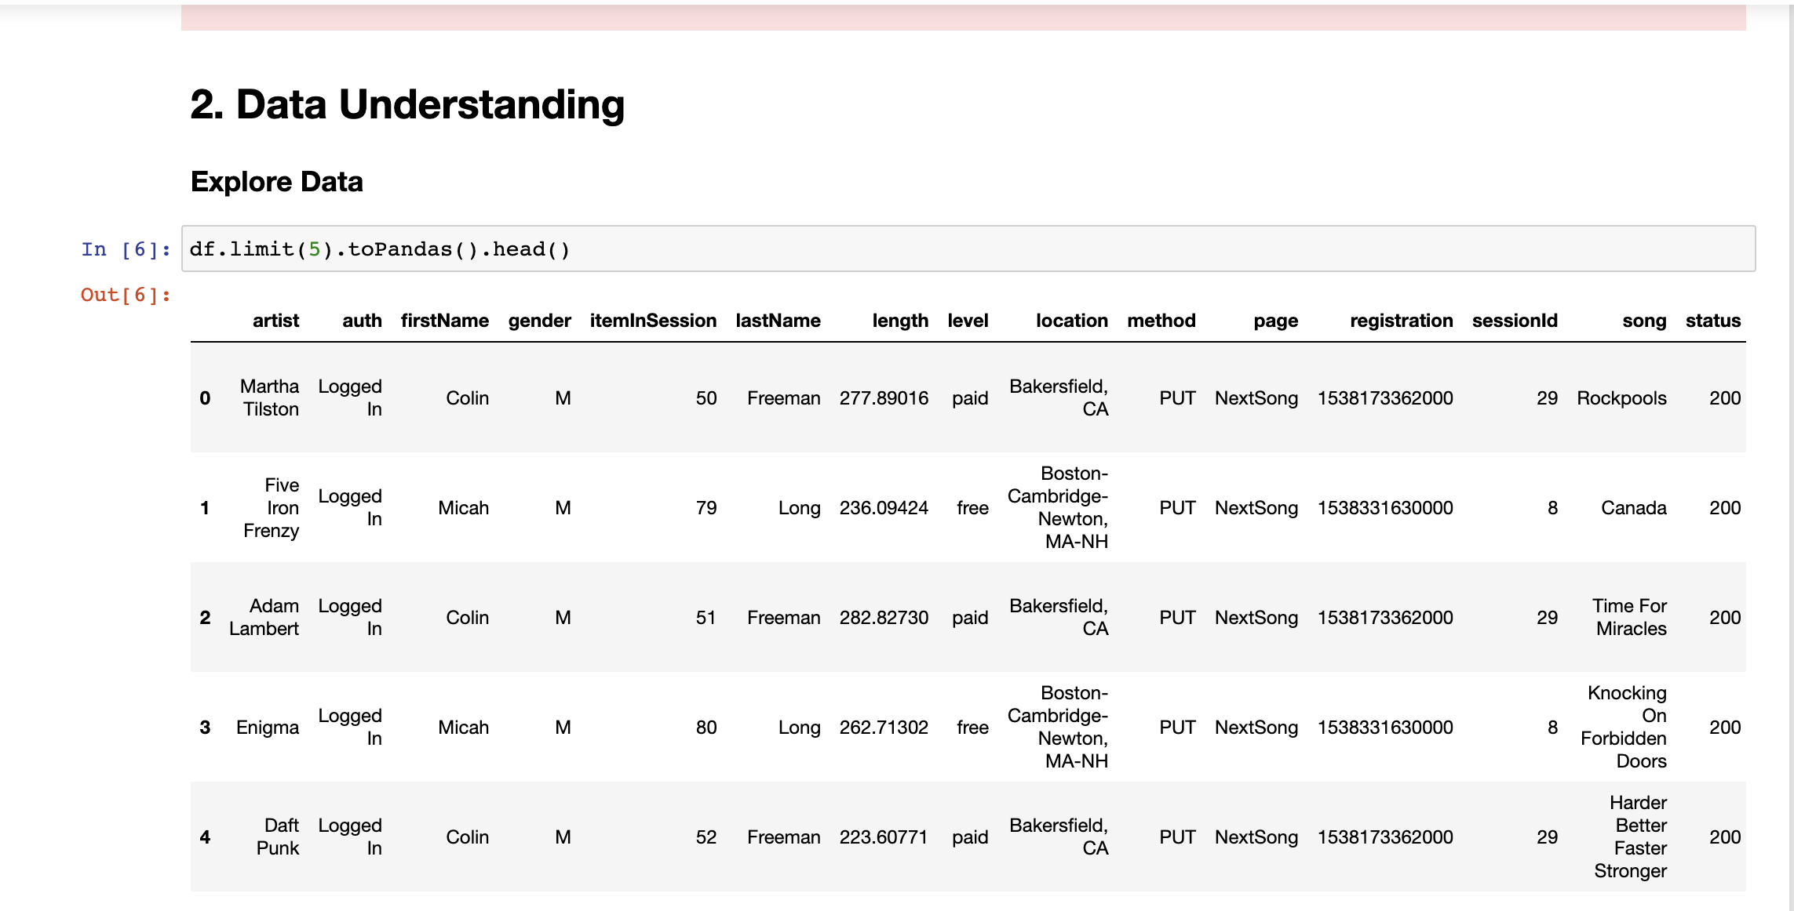
Annexure – Snippet of Code

